Slide 2
PROVING YOUR FAITH: What Message do you Bring ?

Slide 3
EXODUS 3 : 14
. . . I AM . . .

Slide 4
A Message to the Bride.

Slide 5
EXODUS 3 : 14
. . . I AM . . .

Slide 6
Did Jesus ever
say he was The God?

Slide 7
JOHN 8 : 53 - 59
. . . why stone him? . . .

Slide 8
“I and my Father are one”.
“If you have seen me you have seen The Father”.
“Are you the messiah? I am he”.

Slide 9
The Bride will know Jesus Christ in a personal, present tense relationship of the “I AM”.

Slide 10
63-0324E The Seventh Seal
299 And just then He picked me up. He took me up, and sit me way up high, to where a meeting was going on. Looked like a tent or a cathedral, of some sort. And I looked, and there was a little box, like, little place over in the side.

Slide 11
63-0324E The Seventh Seal
And I seen that Light was talking to somebody, above me, that Light that you see there on the picture. It whirled away from me, like that, and went over that tent. And said, “I’ll meet you there.” And said, “This will be the Third Pull, and you won’t tell It to nobody.”

Slide 12
63-0324E The Seventh Seal
And in Sabino Canyon, He said, “This is the Third Pull.”
300 And there’s three great things that goes with It. And one unfolded today, or, yesterday; the other one unfolded today; and there’s one thing that I cannot interpret, because it’s in an unknown language.

Slide 13
What is The Book that was Sealed?

Slide 14
The opening of the
Plan of Redemption
is the
Message to the Bride!

Slide 15
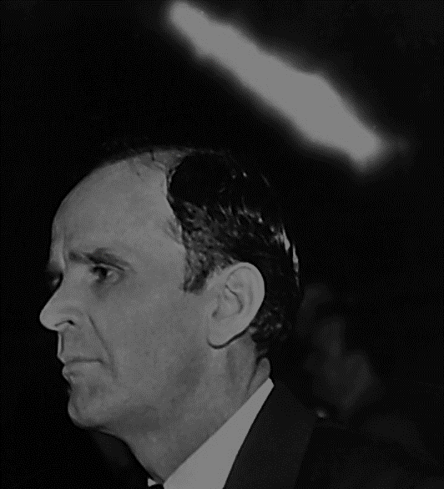
64-1212 The Harvest Time
51 And there is no man worthy to open the Book, or to loose the Seals thereof; but the Lamb, that was slain from the foundation of the world, come took the Book and loosed the Seals. O Lamb of God, come this morning, open the Book to us, and let us look in with Thee, Lord, and see what we must do to be prepared for this hour.

Slide 16
Who can receive this Message?

Slide 17
56-0408A What Is A Vision?
103 And a real kind gentleman walked out to the platform, said, “While Brother Branham is resting, just a few moments,” he said, “we’ll call the prayer line.”

Slide 18
56-0408A What Is A Vision?
And said, “Everyone with prayer cards beginning with a certain number, stand over, on to the right.” Well, I noticed the prayer line, seemed like it went all around the tent, and out, and down the street. Such a prayer line!

Slide 19
56-0408A What Is A Vision?
104 And I looked over, which was then to my left; and that would be to my right, if I was standing on the platform, would be that way.

Slide 20
56-0408A What Is A Vision?
There’s a piece of canvas stretched there. And in behind this canvas was a little, square building, about twelve-foot across and twenty-foot long, something like that. Well, I stood and looked at that.

Slide 21
56-0408A What Is A Vision?
105 And I seen them bringing a lady up, on a stretcher. And there was a lady there taking her name and things, on a paper. And so there’s someone come and got her, and pushed her through. And the next man come through, was with crutches. I see them go through that little building.

Slide 22
56-0408A What Is A Vision?
And on the outside, the lady come out, screaming to the top of her voice, pushing this stretcher. And the…
Then there was another lady on the other side, looked like kind of a dark-haired woman, and she said, “What happened?”

Slide 23
56-0408A What Is A Vision?
106 She said, “I just don’t know.” She said, “I couldn’t tell you what happened.” She said, “I have been paralyzed for twenty years. And, looky, I feel like I never was sick.”

Slide 24
56-0408A What Is A Vision?
And just then, out come the man, leaping and jumping, with his crutches in his hand. And I looked at that. And just then…

Slide 25
56-0408A What Is A Vision?
107 Now, here is something. Notice close. There’s a difference between the Angel of the Lord and that Light. Because, I heard something moving, as It does when It comes here at the platform, at night, kind of like a “Whew! Whew! Whew!” and like a Fire whipping around, licking blaze.

Slide 26
56-0408A What Is A Vision?
And It left me, and It went right down over the top of that audience, and went and stood over the top of that little building, then settled down on top of it.

Slide 27
56-0408A What Is A Vision?
And then, when It did, this One that was standing by me, behind me, the same Voice, the Angel’s Voice, He said, “I’ll meet you in there. And this is the Third Pull, but nobody will know nothing about it.”

Slide 28
56-0408A What Is A Vision?
And I said, “Well, I don’t understand. Why in there? Why there?”
He said, “It will not be a public show, this time.”
And I said, “I don’t understand, going into that closet like that.”

Slide 29
56-0408A What Is A Vision?
108 And He said, “Is not It written by our Lord, ‘When thou prayest, be not like the hypocrites who like to be heard before men. But enter into the secret closet and pray to the Father Who seeth in secret; …

Slide 30
56-0408A What Is A Vision?
… and He Who seeth in secret shall reward thee openly’?” It’s perfectly to the Scripture. Every time, it is.

Slide 31
Prodigal Son

Slide 32
PROVING YOUR FAITH: What Message do you Bring ?

